Slide 1
PatternFinder:
Symbolic Music Retrieval
David Garfinkle
McGill University
SIMSSA Workshop XIX
Montreal, Saturday September 21st 2019
Notes:
Hi I’m david, I’ll be presenting PatternFinder, a software tool I built for symbolic music retrieval
I think my presentation builds on the previous one in that a graphical query language precisely defines the musical passage that we’re interested in, that we want to find in a larger corpus of digitally encoded sheet music
My project is about implementing a system that will find occurrences of that query and return a set of results

Slide 2
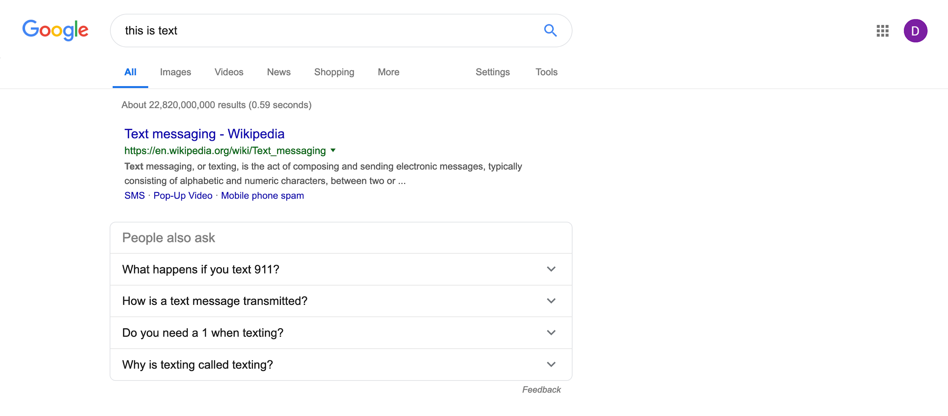
Search Text With Text

Slide 3
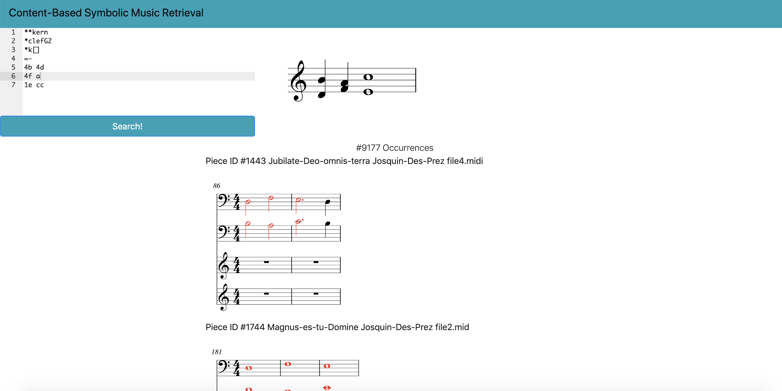
Search Music With Music

Slide 4
Symbolic Content-Based Music Retrieval
Search music by its content: Given a musical passage, find all of its occurrences (and/or similar occurrences) in a corpus of digitized music scores.
PatternFinder is software for symbolic music retrieval
Python package using music21: https://github.com/ELVIS-project/patternfinder
You can use PatternFinder’s web application at https://patternfinder.elvisproject.ca
Notes:
This task is called symbolic content-based music retrieval. To clarify, we are searching through sheet music, not audio, and
“Symbolic” notation meaning that we’re searching through music encodings such as XML, MIDI, MEI.
And “content-based” because we are searching for music through its content, not its metadata
Patternfinder is available as a python package and as a web service. In this presentation I will explain how to use the patternfinder web application and what kind of searching it can do for you.

Slide 5
PatternFinder Web Application: https://patternfinder.elvisproject.ca
Query with the digital music representation “**kern”
Search to find occurrences of our musical passage
Filters to expand or narrow search results
Add a piece (e.g. from SIMSSA DB)
Search over a collection of pieces
Notes:
So, the web application has five components
Search: an algorithm that will actually do the search through a database of digitally encoded sheet music

Slide 6
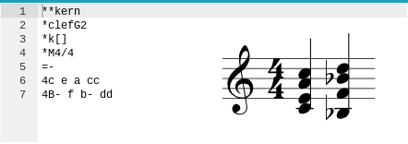
Entering Your Query
Clef
Key Signature
Time Signature
Notes:
The first thing we’ll do is show you how to input your query.
The query is input using a music encoding format called kern. Kern data sort of looks like a music score turned on its side. Rather than time passing vertically, now each row represents a simultaneous moment in time. For example, we see the vertical Bb major chord on the right hand side corresponds to the horizontal second row as shown by the blue arrow, and the horizontal bass voice which descends from C to Bb is represented by a vertical column as shown by the red arrow. Repeated letters and Capital letters are used to specify high and low registers respectively.

Slide 7
Entering Your Query
Clef
Key Signature
Time Signature
Notes:
The first thing we’ll do is show you how to input your query.
The query is input using a music encoding format called kern. Kern data sort of looks like a music score turned on its side. Rather than time passing vertically, now each row represents a simultaneous moment in time. Repeated letters and Capital letters are used to specify high and low registers respectively.

Slide 8
Algorithm to Find Polyphonic Occurrences
Developed at the University of Helsinki in 2011
Searches through polyphonic texture for exact voice leading
Transpositions
Partial matching
Rhythmically altered occurrences
K. Lemström and M. Laitinen. Transposition and time-warp invariant geometric music retrieval algorithms. In Proc. ADMIRE’11, Third International Workshop on Advances in Music Information Research, Barcelona, 2011
Notes:
Ok so, now we’ve written a query in the web application. How will the computer look for it? There are a multitude of methods for searching a large corpus by its musical content. One of the major challenges in content-based music retrieval is finding occurrences in a corpus of specifically polyphonic music, so for now we have implemented one of the few search methods capable of doing this. The method we chose was developed at the University of Helsinki in 2011; it is flexible because it will find all the transpositions of your query, partial matches such as just a subset of the notes you were looking for, and rhythmically altered occurrences occurrences (that is, in any note values--we entered our query in quarter notes, but it will find minims, semibreves, and breves)
Since the algorithm’s true strength is the second point, finding your query in a polyphonic texture, I would like to show you an example of this

Slide 9
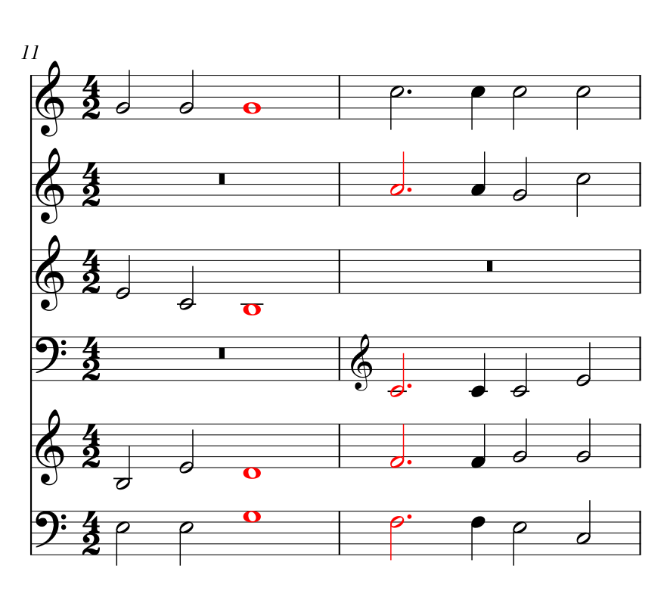
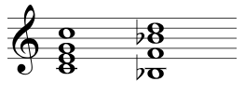
Credo movement of Missa Veni creator spiritus à 6
Query:
Notes:
Consider the following query written on the right hand side:
We look for it in the entirety of palestrina’s masses
First we notice that this is a transposed occurrence: the C major chord has been transposed up a fifth to correspond to the G major chord, colored in red on the left. The algorithm is capable of finding the query when all the pitch content is there, but actual connections between the voices are not made. This is an important distinction
The algorithm is not searching voice by voice but rather, it searches for your query within the entire polyphonic texture as a whole

Slide 10
Filters
Partial matches: how many notes of our query do we want to find?
Chromatic transpositions: what transpositions of our query do we care about?
Intervening notes: how thick is the polyphonic texture which obscures our query?
Notes:
But, this can lead to a lot of freedom in how the algorithm will return occurrences of your query, so we provide filters to expand or narrow the search results
Partial matches: how many notes of the query does the algorithm need to find? All, or some percentage?
Transpositions: what chromatic transpositions are we interested in?
Intervening notes: given an occurrence of our query, how thick is the polyphonic texture which obscures it?
first we define exactly what we mean by “intervening notes.” This can be thought of some measure for the polyphonic texture. The idea is, as we increase the tolerance of intervening notes, we allow extra contrapuntal or harmonic behaviour to occur in between notes found in the score that belong to our query.

Slide 11
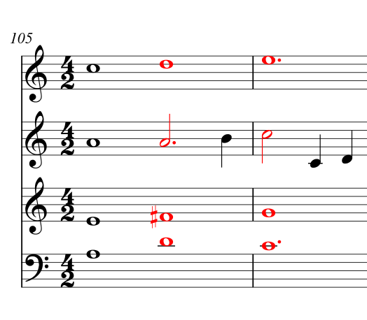
One intervening note
Query:
“Gloria” movement of In te domine speravi à 4
Notes:
For example, consider measure 105 of the Gloria movement in Missa In te Domine speravi (sper-ah-vee). Here we see our familiar two root-position major chords descending by whole step and transposed up by one whole tone. In this example, the major chords walk through our two-chord progression with a passing note in the Alto voice. This occurrence of our query has one intervening note, namely, the passing B in the Alto voice. The filter would ignore this occurrence if it was set to 0 intervening notes.
/*
But how do we count “intervening notes”? As examples get more complicated, we might have another intervening note in the Soprano, or two in the Bass.
*/

Slide 12
Integration with SIMSSA DB
The system was designed with the future intent of integrating with SIMSSA DB
Add pieces
Search by collection
Notes:
Much of the functionality we’ve seen in this presentation thus far was covered last year, too. So what’s new with this system? This year we worked on making a web service that can be integrated with SIMSSADB with two new features

Slide 13
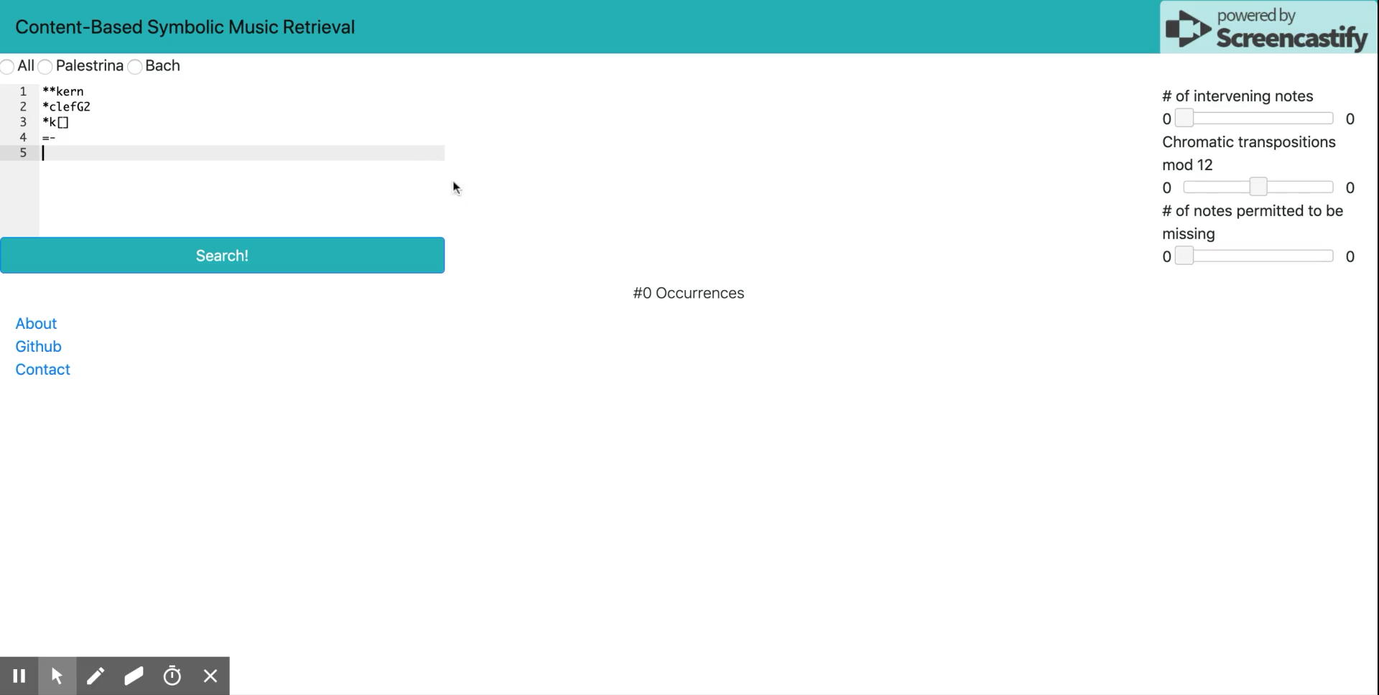
Demo

Slide 14
Future Work
Just monophonic search
Integrate with SIMSSA DB
Rhythmic filters
Ranking results

Slide 15
